Slide 1
Setlister
February 20 2015

Slide 2
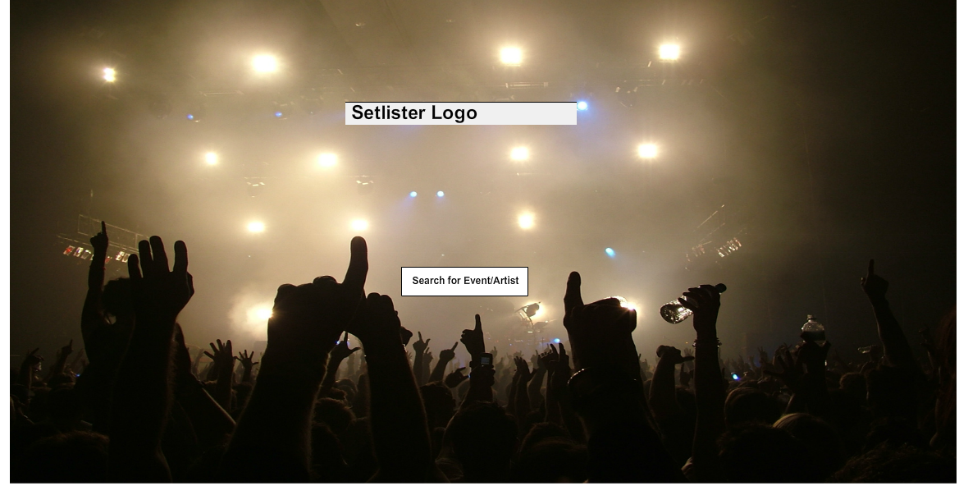

Slide 3


